Slide 1
CAPSTONE PROJECT IBM DATA SCIENCE SPECIALISATION
COMPARING 2 POPULAR CITIES OF INDIA
Amritsar and delhi
BY- ashish kumar

Slide 2
BUSINESS PROBLEM
Amritsar and Delhi are the 2 popular cities in India . Both of these cities are located in North India. So, with this project we shall compare these 2 cities on the basis of the popular venues in these cities using the neighborhood data. By this project we shall see the similarities and dissimilarities between these 2 cities.This is a project that attempts to analyze the neighborhoods in each of these two cities and tries to understand what is popular in them and what they have to offer to someone who is contemplating to make a choice on seeking a life in either of the cities.The business problem in this study assumes that people who would be interested in this study are those who would like to create a projection of potential life and activities in the neighborhoods of the city if the subject moves to live in one of them.The decision to choose one over the other would depend on popular venues in the neighborhoods in each of these cities.

Slide 3
DATA
DATA REQUIRED
List of neighbourhoods of Amritsar and Delhi
Latitude and Longitude data related to neighbourhoods
Data of venues
SOURCES OF DATA
Dataset of neighborhoods (Click here)
Pgeocode package for latitudes and longitudes
Foursquare api for venue data

Slide 4
Methodology
Read the data of Amritsar and Delhi into 2 dataframes
Get latitude and longitude for neighbourhoods using pgeocode
Use Foursquare Api to get venue data with 2000 metre radius
Group data by neighbourhood by taking mean of frequency of occurrence of each venue category
Sort the venues data by most common venues in neighbourhood
Perform clustering on data using k-means clustering
Visualize clusters formed on a folium map

Slide 5
RESULTS

Slide 6
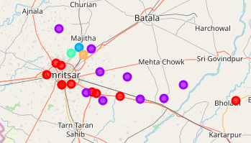
Clusters formed for Amritsar
Cluster 0 is popular with Cafe, Vegan restraunts, Theme park, Punjabi Restraunts, ATM
Cluster 1 is popular with ATM’s, Dhaba, Toll booth, Super markets
Cluster 2 is popular with farm, vegan restraunts
Cluater 3 is popular with Clothing store Vegan restraunts
Cluster 4 is popular with Indian restraint, Toll booth, Accessorie store

Slide 7
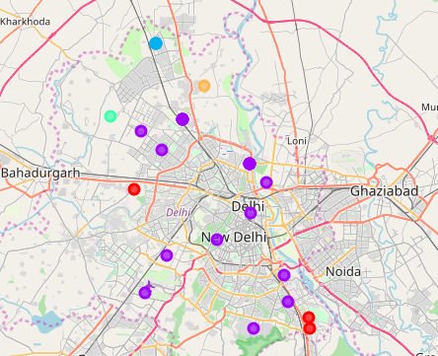
Clusters Formed for Delhi
Cluster 0 is popular with train stations,ATM’s and Indian restraunts
Cluster 1 is popular with Café, hotel, Restraunts, flea market, mobile phone shops
Cluster 2 is popular with women’s store, ATM’s, Electronic stores
Cluster 3 is popular with ATM, Vietnamese restraint
Cluster 4 is popular with farm and resort

Slide 8
Discussion
Given the cluster information for both Amritsar and Delhi, we see that both these cities and its neighbourhoods are a great place for a foodie. There are a lot of restaurants, cafes, bars, etc in these neighbourhoods. The difference is that Amritsar is popular for most probably Vegan, Indian and punjabi restraunts but apart from indian food Delhi also offers all types of international cusines. Thus Delhi is more preferable for foodies and Amritsar is also preferable for foodies who like vegetarian food. Thus But Amritsar also has theme parks, museums which would be good for tourists.
Another observation is that the number of venues Delhi has to offer are far too many as compared to Amritsar. This means Amritsar becomes restrictive in terms of variety and convenience. So, it depends on the choices, needs and preferences of the person where he would like to live.

Slide 9
Conclusions
In this project, we have analyzed the neighborhoods of India’s two prime cities Amritsar and Delhi on the basis of their top and popular venues. We have clustered the neighborhoods based on top 5 most common venues in the neighborhood of each of these cities. My intention with this project was to analyze and understand the difference in the type of life in these cities, which can offer decision points for anybody who is considering to settle in either of these cities and can get a peek into what type of experience and facilities he will be provided with.

Slide 10
THANK YOU

